Slide 1
E-Commerce
Chapter 1:
Introduction to Electronic Commerce

Slide 2
Electronic commerce (e-commerce)
  Shopping on the part on internet
  Includes other activities
  Businesses trading with other businesses and internal processes that companies use to support their buying, selling hiring, planning and other activities.

Slide 3
Electronic business (e-business)
  Term used interchangeably with e-commerce
  The transformation of key business processes through the use of Internet technologies

Slide 4
Categories of Electronic Commerce
Five general e-commerce categories
  Business-to-consumer (B2C)
  Business-to-business (B2B)
  Business processes
  Consumer-to-consumer (C2C)
  Business-to-government (B2G)/ e-procurement
Supply management or procurement
  Departments devoted to negotiating purchase transactions with suppliers
  E.g. speakers

Slide 5
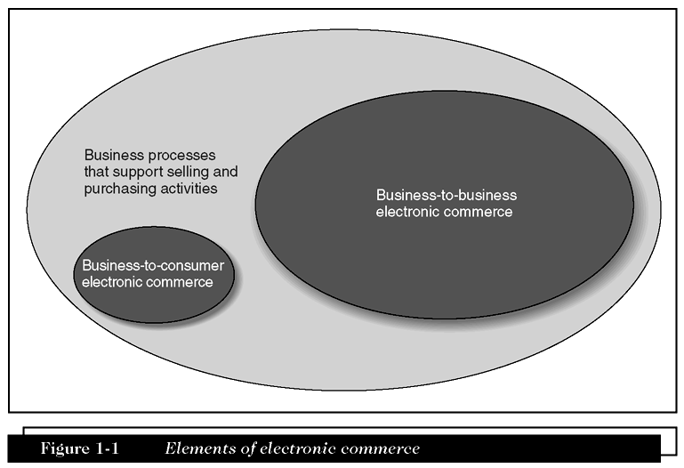
Elements of Electronic Commerce

Slide 6
Transaction
  An exchange of value like purchase, sale or conversion of raw material to finished product
Business processes
  The group of logical, related, and sequential activities and transactions in which businesses engage
Telecommuting or telework
  Employee logs in to company computer through Internet instead of traveling to office

Slide 7
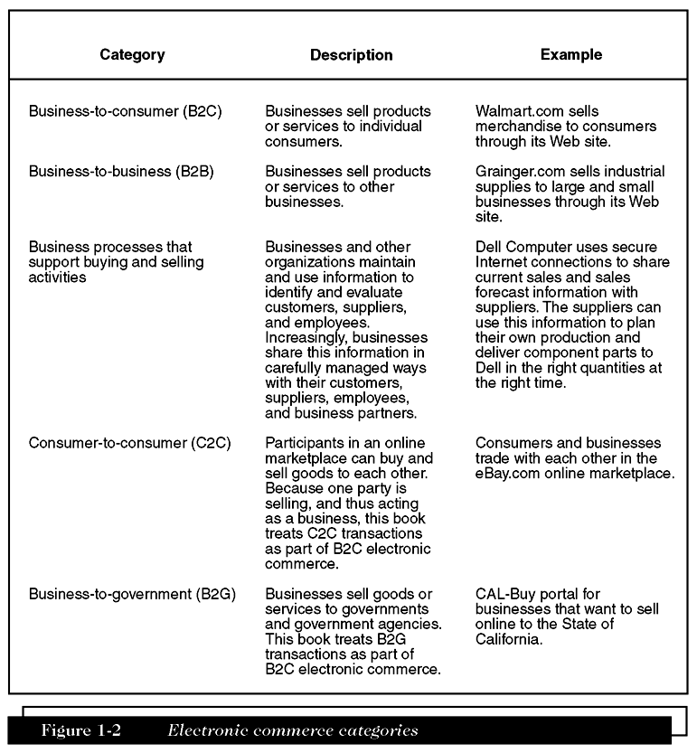
Electronic Commerce Categories

Slide 8
Business Models, Revenue Models, and Business Processes
Business model
  A set of processes that combine to yield a profit
Revenue model
  Used to
    Identify customers
    Market to those customers
    Generate sales to those customers

Slide 9
Focus on Specific Business Processes
Merchandising
  Combination of store design, layout, and product display knowledge
Commodity item
  Hard to distinguish from the same products or services provided by other sellers
  Features have become standardized and well known

Slide 10
Shipping profile
  Collection of attributes that affect how easily a product can be packaged and delivered
High value-to-weight ratio
  Can make overall shipping cost a small fraction of the selling price

Slide 11
Product / Process suitability to e-commerce
E-commerce | Both | Traditional commerce
Sale/purchase of books and cds | Sale/ purchase of automobiles | Impulse items for immediate use
Online delivery of software | Online banking | Low value transactions
Sale/ purchase fo travel services | Hostel booking
Online shipment tracking | Sale / purchase of residential area
Sales/ purchase of investment and insurance products | High value jewelry and antiques

Slide 12
Advantages of Electronic Commerce
Can increase sales and decrease costs
If advertising done well on the Web
  Can get a firm’s promotional message out to potential customers in every country
Using e-commerce sales support and order-taking processes, a business can
  Reduce costs of handling sales inquiries
  Provide price quotes

Slide 13
Advantages of Electronic Commerce (Continued)
Increases purchasing opportunities for buyer
Negotiating price and delivery terms is easier
The following cost less to issue and arrive securely and quickly
  Electronic payments of tax refunds
  Public retirement
  Welfare support

Slide 14
Disadvantages of Electronic Commerce
Perishable grocery products are much harder to sell online
Difficult to
  Calculate return-on-investment
  Integrate existing databases and transaction-processing software into software that enables e-commerce
Cultural and legal obstacles also exist

Slide 15
Economic Forces and Electronic Commerce
Economics
  Study of how people allocate scarce resources
Two conditions of a market
  Potential sellers of a good come into contact with potential buyers
  A medium of exchange is available

Slide 16
Transaction Costs
Total costs that a buyer and seller incur
Significant components of transaction costs
  Cost of information search and acquisition
  Investment of seller in equipment or in the hiring of skilled employees to supply product or service to buyer

Slide 17
The Role of Electronic Commerce
Businesses and individuals
  Can use electronic commerce to reduce transaction costs by
    Improving flow of information
    Increasing coordination of actions
Vertical Integration: practice of an existing firm replacing one or more of its supplier markets with its own hierarchical structure for creating the supplied product

Slide 18
Value Chains in Electronic Commerce
Strategic business unit
  One particular combination of product, distribution channel, and customer type
Firm
  Multiple business units owned by a common set of shareholders
Industry
  Multiple firms that sell similar products to similar customers

Slide 19
Strategic Business Unit Value Chains
Value chain
  A way of organizing the activities that each strategic business unit undertakes
Primary activities
  Design, produce, promote, market, deliver, and support the products or services it sells
Supporting activities
  Human resource management and purchasing

Slide 20
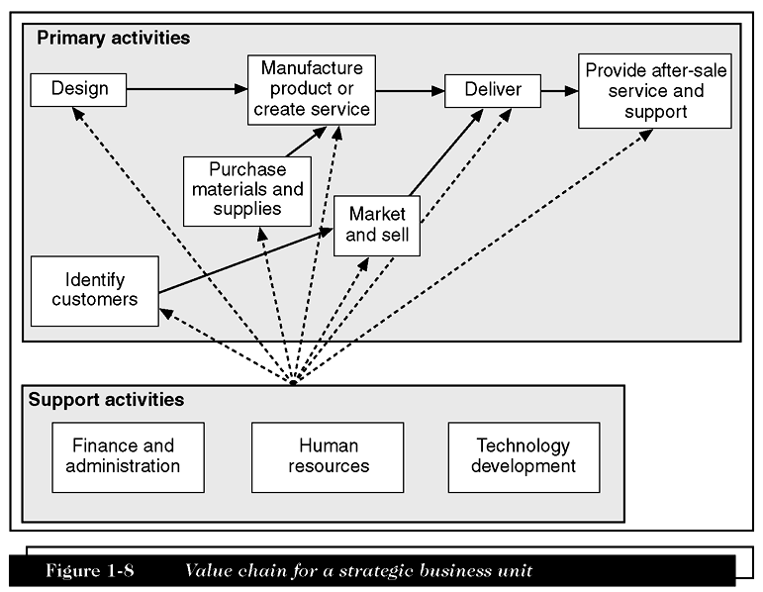
Value Chain for a Strategic Business Unit

Slide 21
Industry Value Chains
Value system
  Larger stream of activities into which a particular business unit’s value chain is embedded
  Also referred to as industry value chain

Slide 22
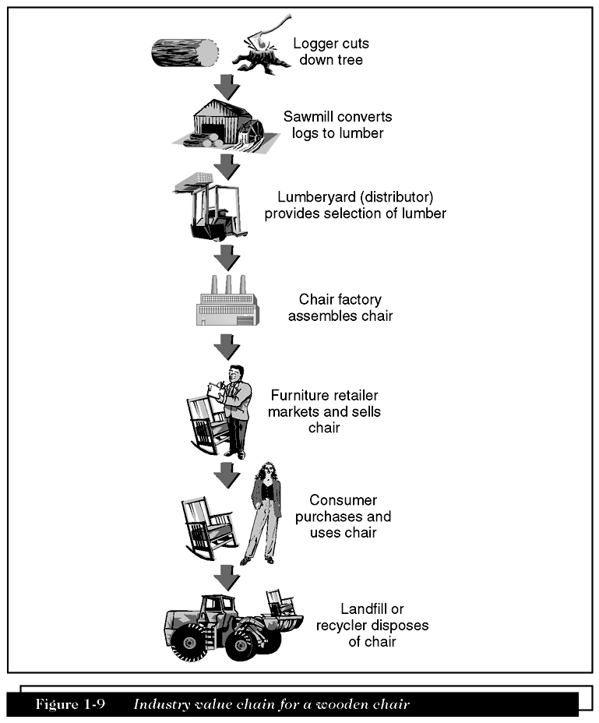
Industry Value Chain for a Wooden Chair

Slide 23
International Nature of Electronic Commerce
Companies with established reputations
  Often create trust by ensuring that customers know who they are
  Can rely on their established brand names to create trust on the Web
Customers’ inherent lack of trust in “strangers” on the Web
  Logical and to be expected

Slide 24
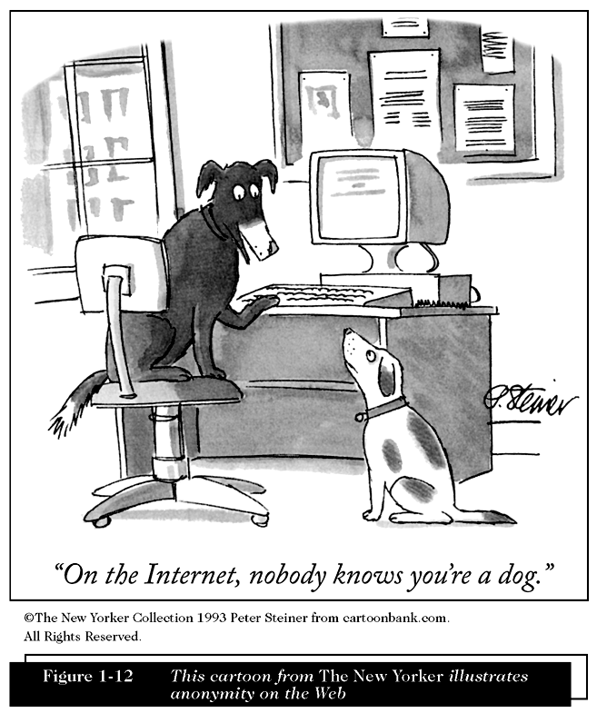
This Cartoon from The New Yorker Illustrates Anonymity on the Web

Slide 25
Language Issues
To do business effectively in other cultures
  Must adapt to culture
Researchers have found that
  Customers are more likely to buy products and services from Web sites in their own language
Localization
  Translation that considers multiple elements of local environment

Slide 26
Culture Issues
Important element of business trust
  Anticipate how the other party to a transaction will act in specific circumstances
Culture
  Combination of language and customs
  Varies across national boundaries
  Varies across regions within nations

Slide 27
Infrastructure Issues
Internet infrastructure includes
  Computers and software connected to Internet
  Communications networks over which message packets travel
Organization for Economic Cooperation and Development’s (OECD)
  Statements on Information and Communications Policy
    Deal with telecommunications infrastructure development issues

Slide 28
Infrastructure Issues (Continued)
Flat-rate access system
  Consumer or business pays one monthly fee for unlimited telephone line usage
  Contributed to rapid rise of U.S. electronic commerce
Targets for technological solutions
  Paperwork and processes that accompany international transactions

Slide 29
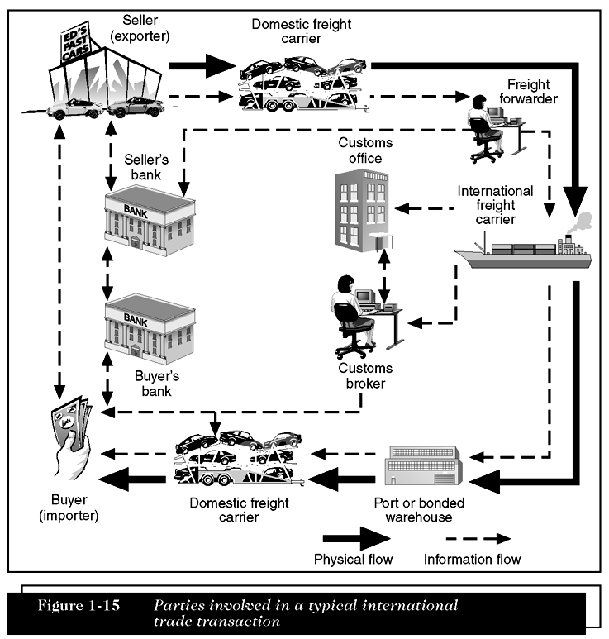
Parties Involved in a Typical International Trade Transaction

Slide 30
Summary
Commerce
  Negotiated exchange of goods or services
Electronic commerce
  Application of new technologies to conduct business more effectively
First wave of electronic commerce
  Ended in 2000
Second wave of electronic commerce
  New approaches to integrating Internet technologies into business processes

Slide 31
Summary
Using electronic commerce, businesses have
  Created new products and services
  Improved promotion, marketing, and delivery of existing offerings
Global nature of electronic commerce
  Leads to many opportunities and few challenges
To conduct electronic commerce across international borders
  You must understand the trust, cultural, and language legal issues

